Slide 1
Determine Trending Research Topics Through Grant Abstracts
CSC 440 Data Mining Final Project Fall 2021
Sarah Siddiqui and Thomas Durkin

Slide 2
Problem Statement
“Considering the entire University of Rochester as well as Computer Science in the United States, how has associated research evolved during the past 20 years?”

Slide 3
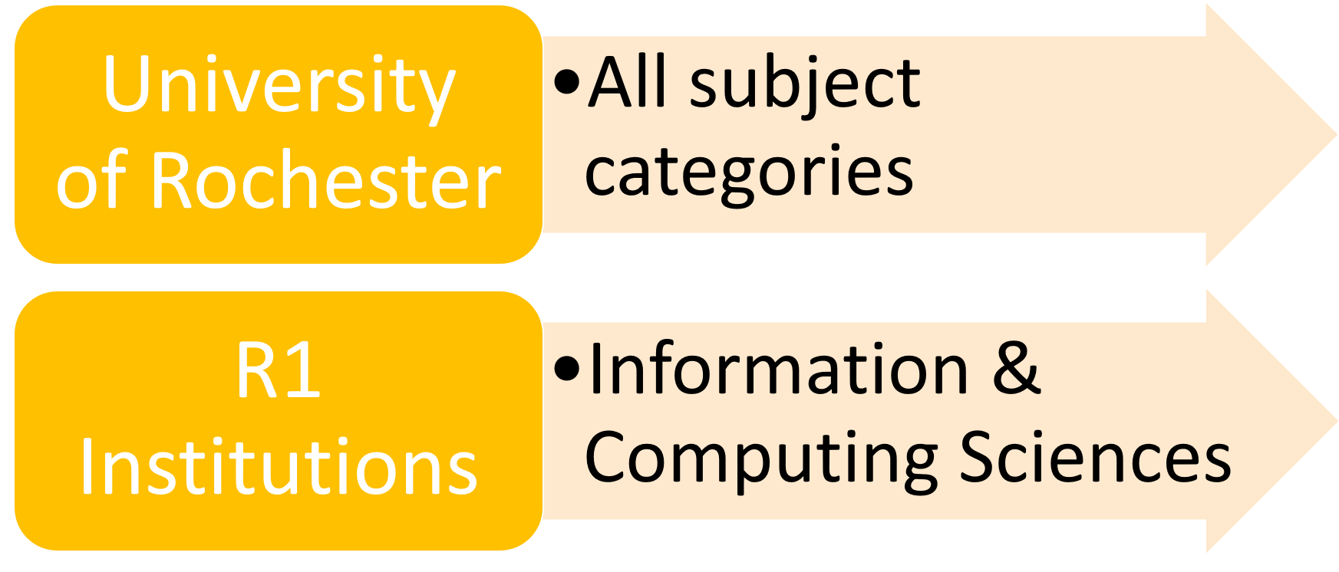
About the data
From the Dimensions Database [1]
Launched in 2018 by Digital Science
2 datasets through the years 2000-2020

Slide 4
Methodology

Slide 5
Preprocessing the Data
Models were built using the Abstract variable
Removed punctuation
Created a list of stop word
Built bigrams and trigrams
Applied lemmatization to the vocabulary
Cleaned the corpus with TF-IDF

Slide 6
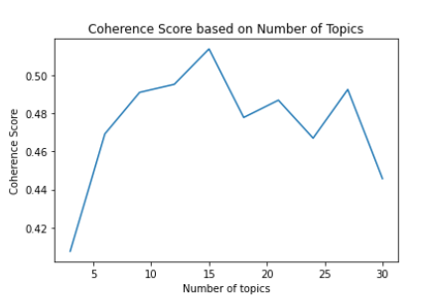
Topic modeling with Python
R1 model
Gensim LDA [2]
Documents are classified into “topics” which are groups of words
Dictionary and Corpus
Find optimal coherence score
BERTopic [3][4]
Clusters of documents with similar topics are created using density based HDBSCAN
Topics over time

Slide 7
1.
University of Rochester

Slide 8
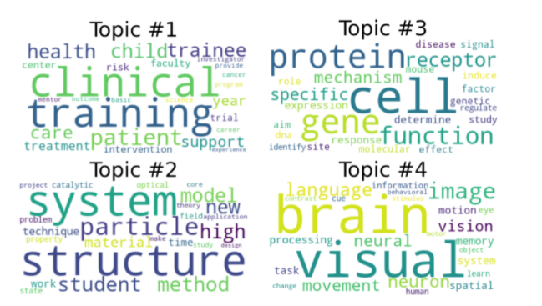
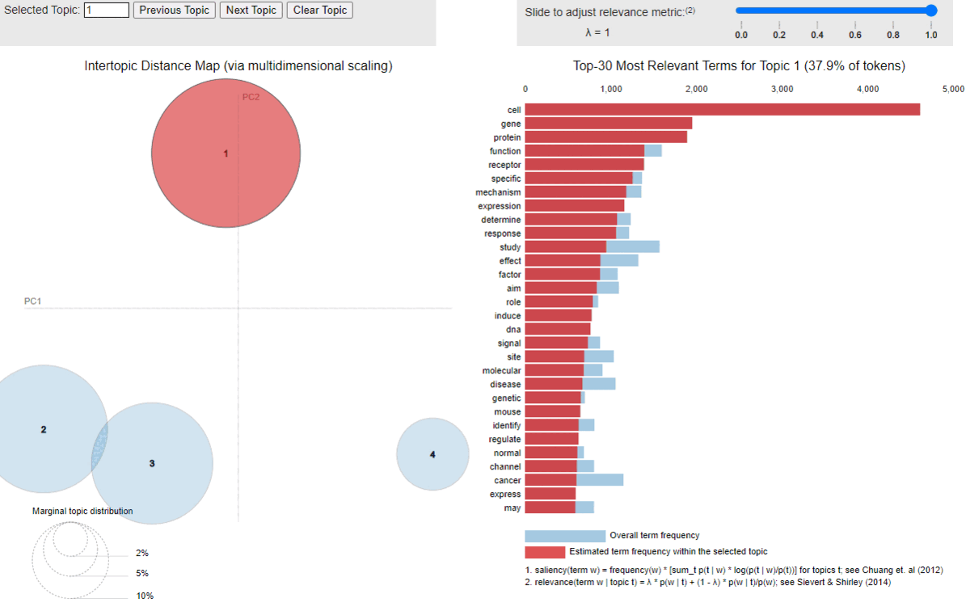
UR LDA Topics 2000-2020
Clinical Sciences & Patient Care
Applied Physics
Genomics
Brain and Imaging Science
Comparable results to the UR
Web of Science Publications

Slide 9
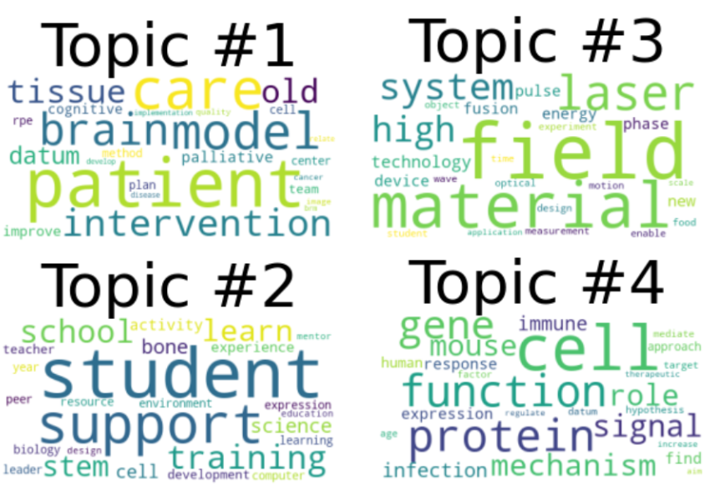
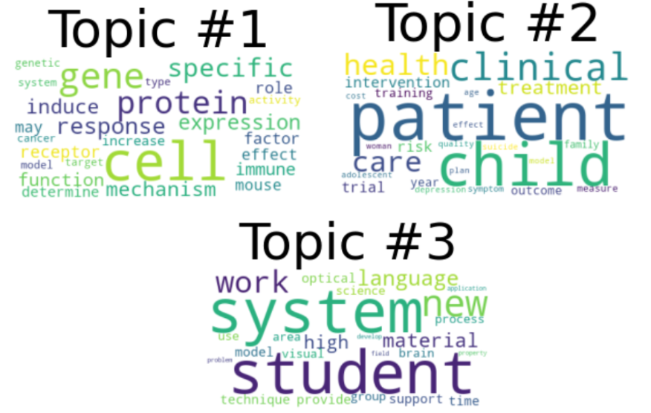
Comparing 2000 with 2020
2020
2000
Laser and field have become prominent in 2020
A focus towards brain research
Genomics is present in both years
Notes:
3 topics in 2000 versus 4 in 2020

Slide 10
LDA Topics for UR in 5 year intervals

Slide 11
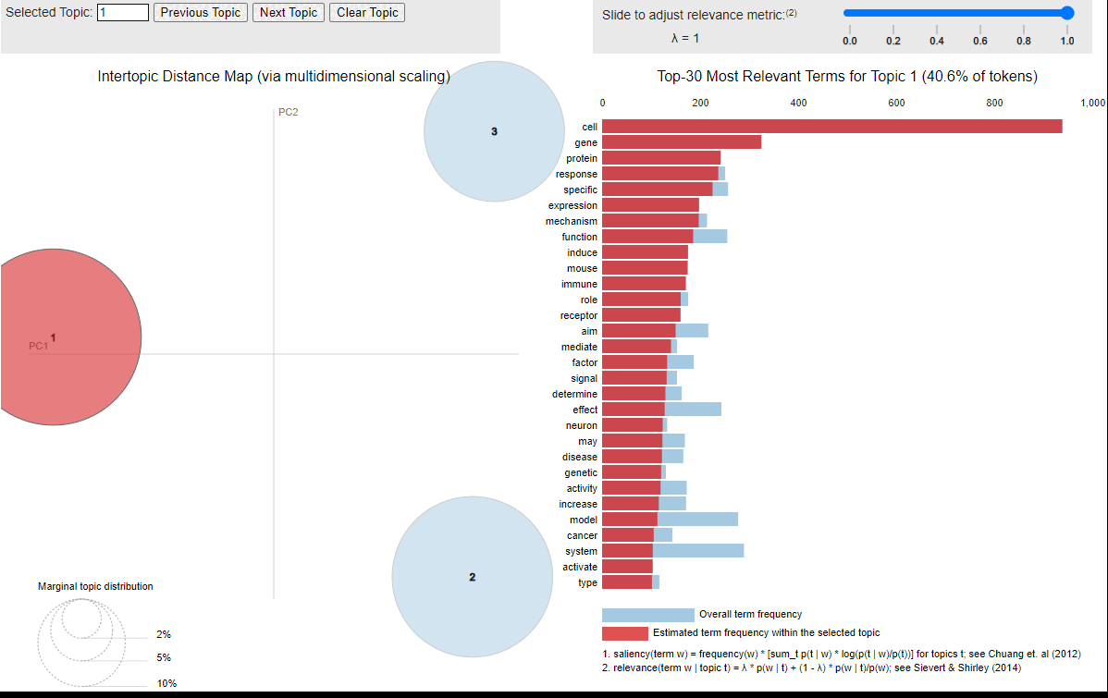
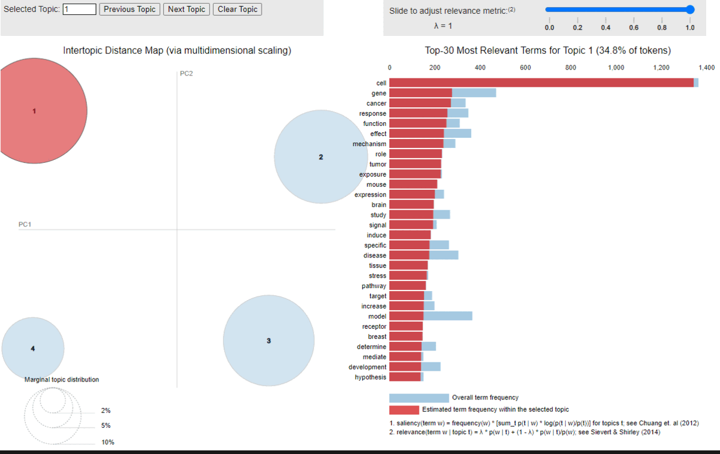
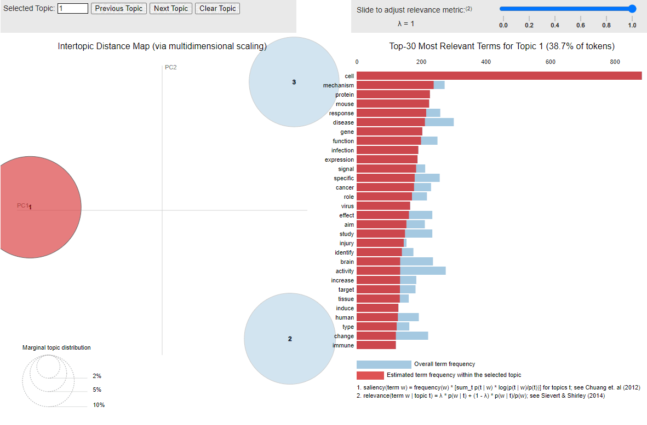
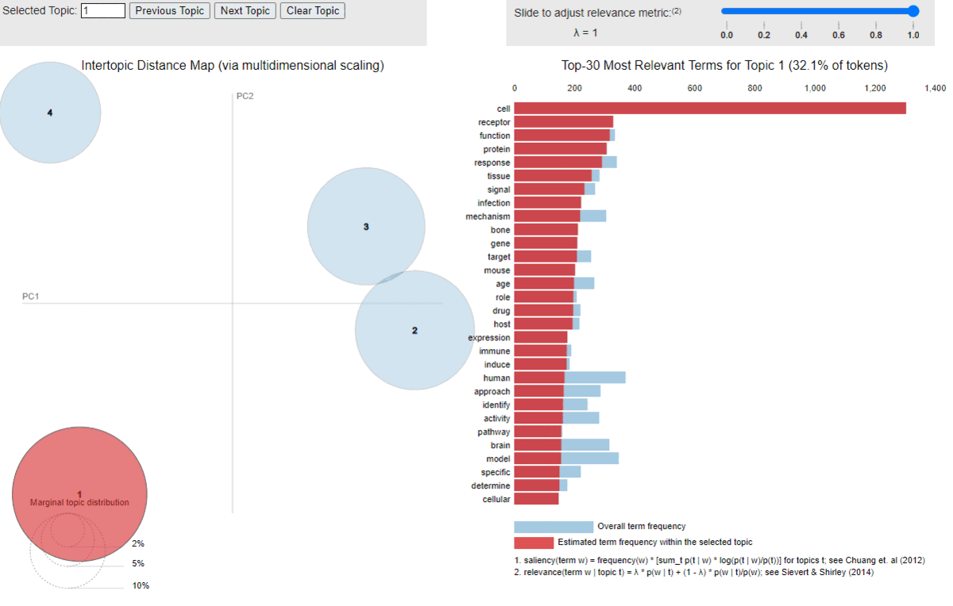
2000-2004
2005-2009
2010-2014
2015-2020
Notes:
Left to right, top to bottom: 2000-2004, 2005-2009, 2010-2014, 2015-2020. Typically there are 3-4 broad topics

Slide 12
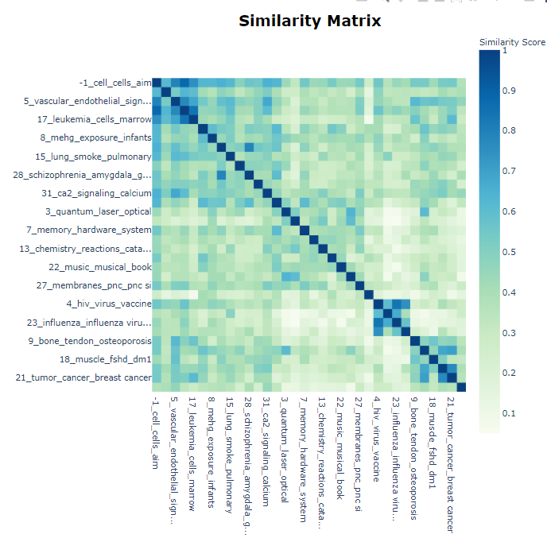
Similarity Matrix for all UR topics generated by BERTopic Model
Notes:
Most of the similar topics are relating to medical fields such as respiratory diseases, viruses, influenza etc. The column with value -1 are words that are too frequent and not considered in topics. Aside from that, the model appears to identify fairly distinct topics

Slide 13
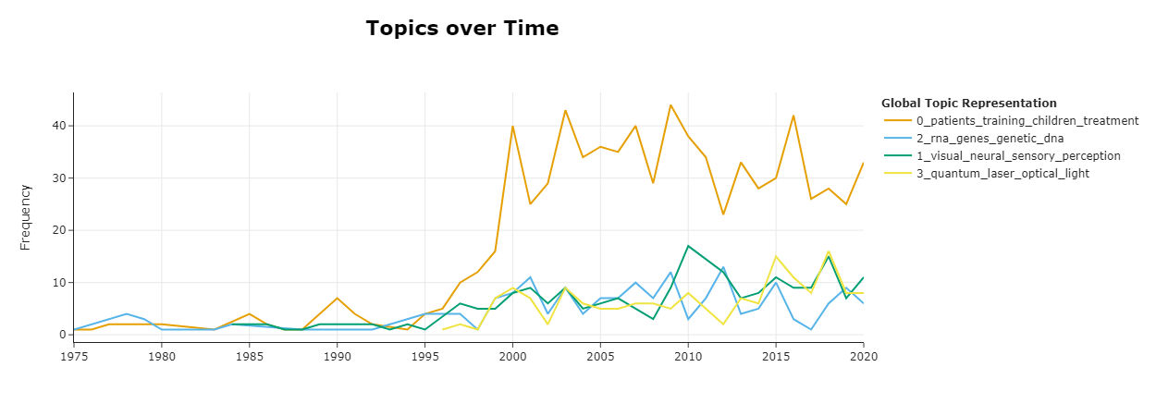
University of Rochester BERTopic Model
Notes:
Focusing on the top 4 topics out of 33 identified

Slide 14
2.
CS at R1 Institutions

Slide 15
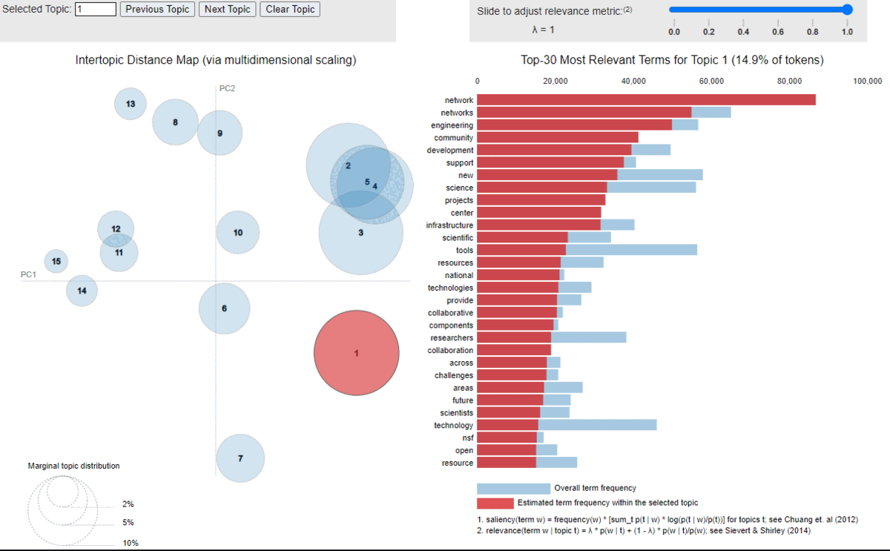
R1 LDA Topics 2000-2020
Identified 15 topics in Computer Science research
Comparable with BERTopic model
Notes:
For Powerpoint, play slideshow to see relevant terms in different topics.
Since the data is bigger, the term frequency in the topics is as high as 100,000.

Slide 16
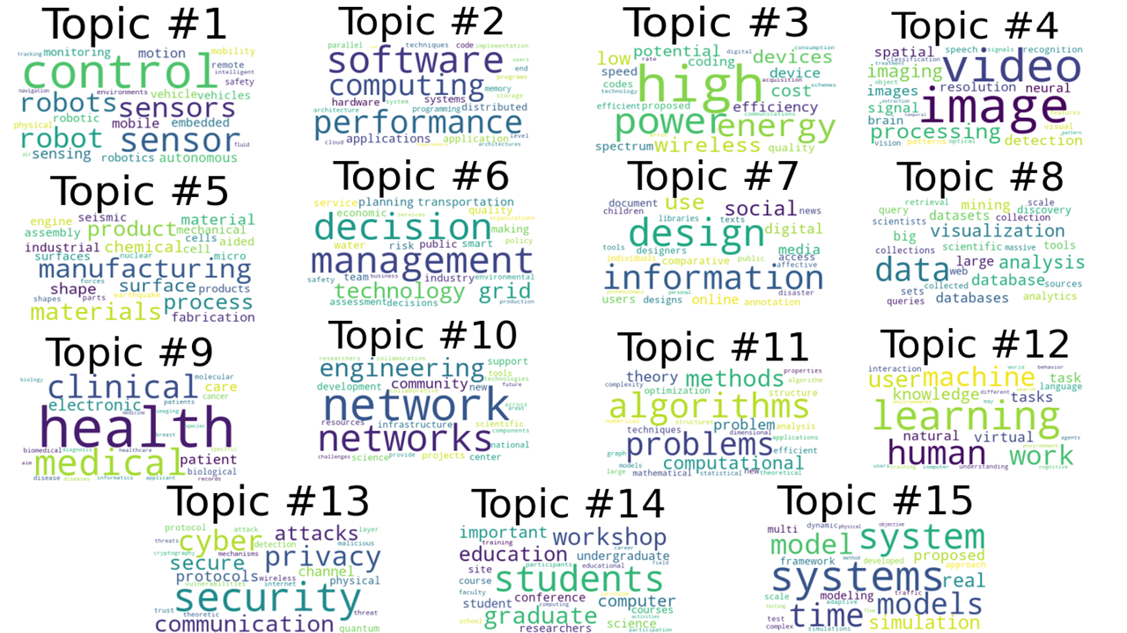
LDA Word Cloud

Slide 17
R1 Institutions BERTopic Model
Model identified 35 topics
Topics are similar to LDA with additional topics covering AI, NLP and HPC which were not explicit in LDA

Slide 18
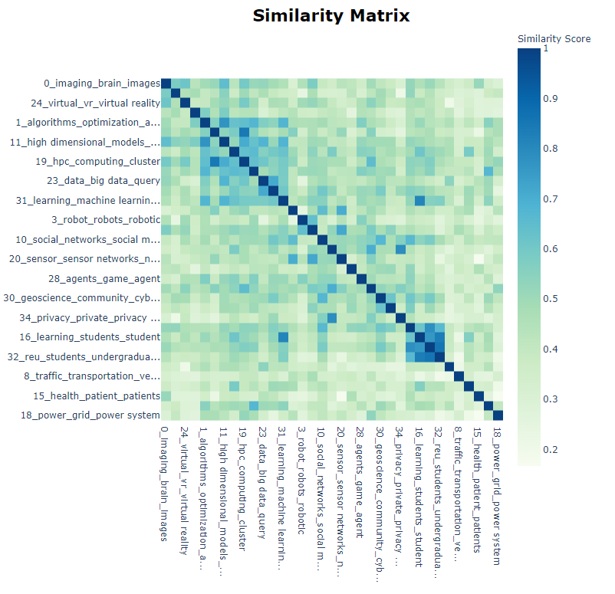
Similarity Matrix for all R1 topics generated by BERT

Slide 19
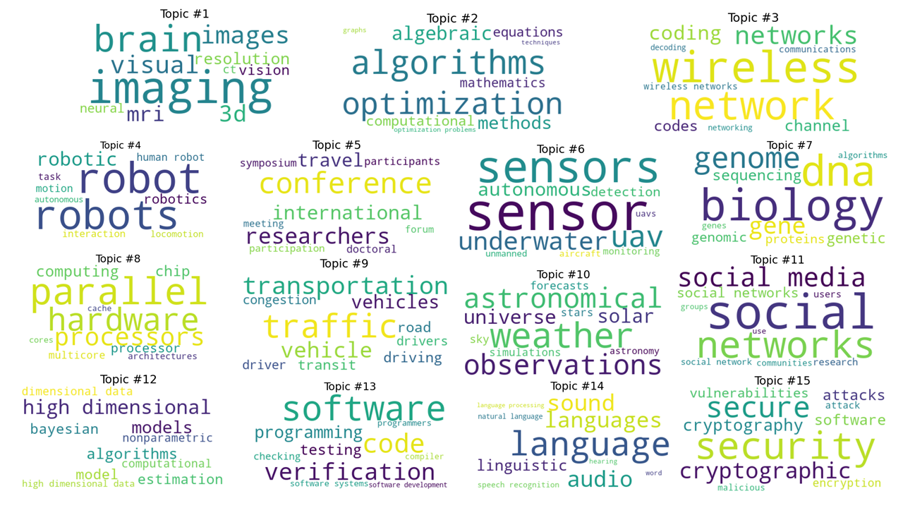
BERTopic Word Cloud for top 15

Slide 20
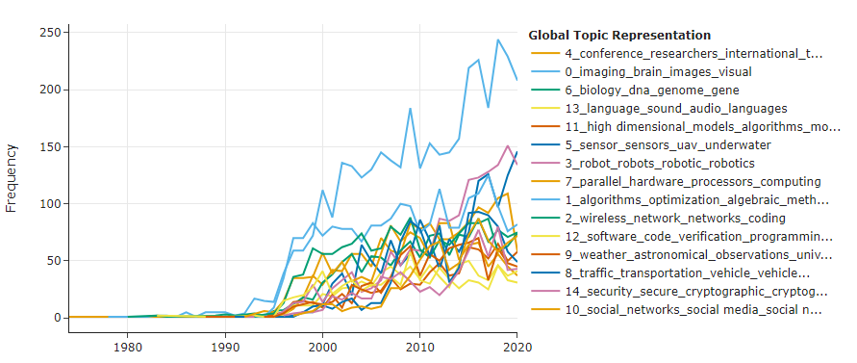
CS at R1 Institutions over the years
Notes:
Imaging, brain, images and visual is above all other topics

Slide 21
Evaluating R1 model
Compared with topics in CS Rankings [5]
Between LDA and BERTopic models we covered majority of topics in CS Rankings
One topic not covered but present in both our models with terms: Conferences, researchers, international, workshop, etc.

Slide 22
Future Work
Get data from more institutions
Compare private vs non-private research
Analyze relationship between funding and research impact [6]

Slide 23
Conclusion
Medical related topics were prevalent throughout all models, for both UR (genomics, patient health, etc.) and R1 institutions (bioinformatics)
Topics relating to lasers and applied physics are more pronounced after 2015
There is an emphasis on conferences and education in Computer Science that we did not expect to see in abstracts

Slide 24
References
[1] Dimensions. Retrieved December 12, 2021 from https://app.dimensions.ai/discover/grant
[2] Radim Rehurek. 2021. Gensim: topic modelling for humans. Retrieved December 10, 2021 from https://radimrehurek.com/gensim/auto_examples/tutorials/run_lda.html
[3] Maarten Grootendorst. 2021. MaartenGr/BERTopic: Major Release v0.7. DOI:https://doi.org/10.5281/zenodo.4719700
[4] Anna Glazkova. 2021. Identifying Topics of Scientific Articles with BERT-Based Approaches and Topic Modeling. In Trends and Applications in Knowledge Discovery and Data Mining, Springer International Publishing, Cham, 98–105.
[5]Emery D. Berger. 2020. CSRankings. 2020. Retrieved December 10, 2021 from https://csrankings.org
[6] Jue Wang and Philip Shapira. 2015. Is There a Relationship between Research Sponsorship and Publication Impact? An Analysis of Funding Acknowledgments in Nanotechnology Papers. PLoS One 10, 2 (February 2015), e0117727. DOI: https://doi.org/10.1371/journal.pone.0117727

